Slide 1



OUTAGE I/O
Outage Info In / Outage Info Out

Slide 2
OUTAGE I/O - Topics
Overview
New Solutions
Improve Communication
Outage Info IN
Reporting via OMSWebMap
Outage Info OUT
New features in OMSWebMap
Outage Alerts App
Notes:
In this session we are going to give you an <click> Overview of <click> New Solutions to help you <click> improve communication about outages both internally within your utility and externally to you consumers.
<click>
We will look at getting outage information IN to OMS from your consumers <click> in the context of Reporting via OMSWebMap
<click>
We will also look at ways to get outage information OUT of OMS
<click>
There are several new features built into OMSWebMap that help communicate outage conditions to your customers.
<click>
Finally we’ll show you our Outage Alerts App that can help you notify key personnel at your utility of outages conditions automatically.

Slide 3
Outage Reporting Definitions
Call: Report of an outage from an active Consumer that resolves to a record in CIS tab of OMS.
Unresolved Call: Report of an outage from a consumer that does not resolve to a record in the CIS tab of OMS.
Case: An Outage Situation in OMS.
Web Form: An internet based form that contains inputs to collect data.
Call Backs: When a call is placed into OMS with a flag that the caller would like to receive a call back in regard to their outage situation.
Notes:
As usual, we will need to first identify / define key terms for this session.

Slide 4
Outage Alerts Definitions
Email Server: The server that handles your email traffic on your internal network.
Email: An electronic message sent over the WWW from one email address to another.
SMS: Short Message Service / Text Message.
Scope: The extent to which an Outage Alert setting applies. System / Case
Threshold: The value used as a measure to trigger an Outage Alert action.
Priority Service: These are consumers such as Hospitals, Waste Water, Oxygen with values coming over from UPN or GIS.
Key Accounts: An account that is considered a high priority. A threshold for a key account can be set for a certain account number or list of account numbers.

Slide 5
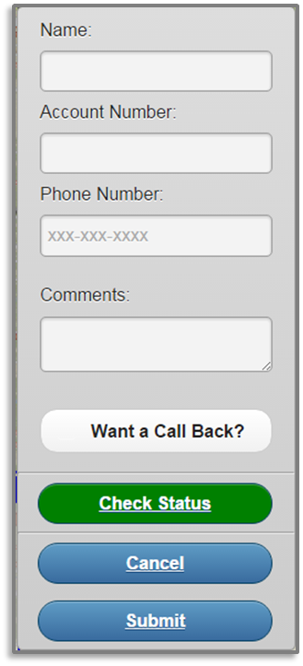
Outage Info IN
Outage Reporting via OMSWebMap
Configuration
Reporting an Outage
Checking Outage Status
Notes:
Outage Reporting from OMSWebMap is accomplished by populating and submitting a web-form from your public facing outage web map. It enables your customers to communicate outage information directly into the system without having to call on the phone.
<click – show web form>
Additional configuration <click> is required before you can enable this solution to give your customers access. We’re going to spend some time taking a look at what is needed to line this up.
Once your configuration is complete, your customers will be able to Report an Outage <click>. We’ll take a look a the criteria for reporting an outage, and how this process looks both on the consumer and the OMS side.
Customers will also be able to check their Outage Status <click> from any web enabled device. This can help cut down on phone calls as it provides consumers with immediate knowledge they are in a known outage.
Note you will have the option to allow consumers to select callback requests from this interface. They can even enter an alternate contact phone number such as a cellular device to be notified once power is restored.
So let’s dive in and take a look at the back end configuration to see what is required before this functionality can go live.

Slide 6
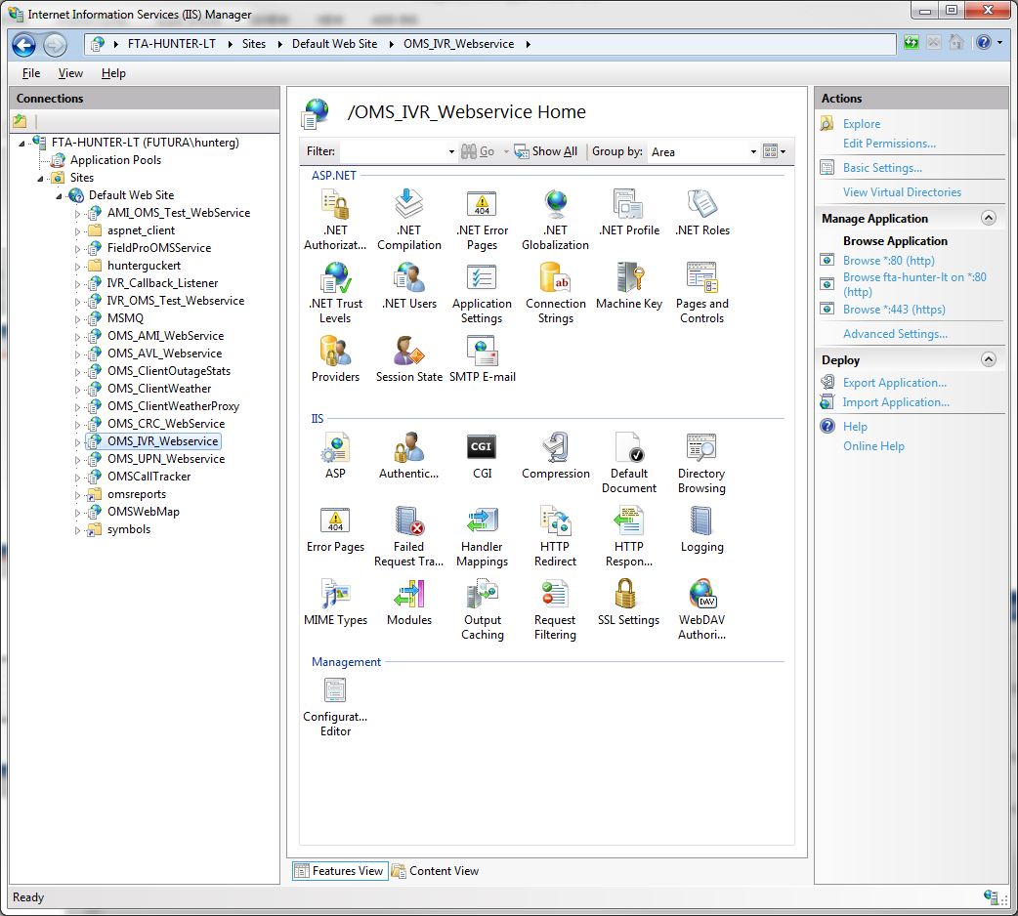
Outage Info IN - OMSWebMap
Machine Configuration
OMS_IVR_Webservice
Hosted by IIS
Handles requests from WWW against OMS Model.
Enable IVR Integration
Network Configuration
Firewall
Ports 5432, 5454, 7820
Need to be open internally between OMS and DMZ
Notes:
First we have specific machine and network configuration that must be in place.
Outage Reporting from OMSWebMap piggy backs on the OMS_IVR_Webservice which will be hosted on the DMZ machine.
<click>
The webservice will need to be installed and configured on your DMZ and the <click> IVR integration will need to be enabled in Integration Control on your OMS Server.
<click>
Network Communication between your DMZ and your OMS Machine will need to be opened up internally over ports 5432, 5454, and 7820.
This will allow the webservice on the DMZ to interact with the OMS Model. It will be used to place calls into the system and check the status of accounts from external web browsers.

Slide 7
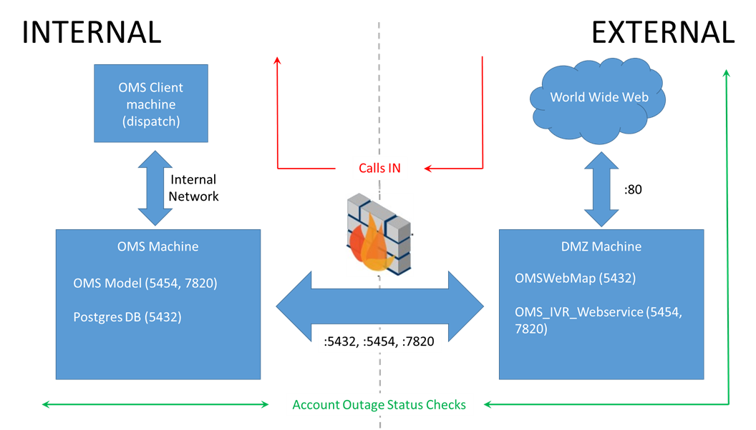
Outage Info IN – OMSWebMap
Notes:
This diagram shows the communication flow of Outage Reporting requests coming from the world wide web into OMS.
Note that this diagram is specific to OMSWebMap ONLY machines. We have a separate architecture for machines that will handle multiple solutions that we’ll cover in the FuturaIVR session.
<click>
Calls (outage reports) entered into OMSWebMap come in from the world wide web <click> to the DMZ on port :80 (or :443)
The OMS_IVR_Webservice hosted by the DMZ handles these requests and <click> passes the transactions through the internal firewall to the OMS Model over ports 5454 and 7820.
The model will receive the call and process it as a resolved or unresolved call based on the input to the web form.
<click>
The OMS Client operator will be able to see that a call from OMSWebMap has just come into the system. The call ticket will have “Taken By: OMSWebMap”.
Outage Status checks also come into the system from the web on port :80. The transactions pass form the external OMS_IVR_Webservice through the internal firewall to the OMS Model. The model assesses account status and a response is generated and sent back through the internal firewall to external webservice. The external webservice gives the response to the web browser that made the request. The end user will see the account Outage Status based on the response it got from the Model.

Slide 8
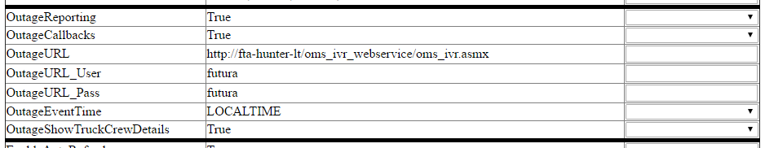
Outage Info IN - OMSWebMap
OMSWebMap Configuration
Notes:
Once your machine configuration and network firewall settings are lined up, we’re ready to configure your OMSWebMap application and enable the Outage Reporting functionality.
This screenshot is from the OMSWebMap/Config interface. As you can see there is a section in the config devoted to the parameters you need for Outage Reporting on OMSWebMap.
<click>
Outage Reporting (True/False) – This setting will enable / disable display of the Report and Outage Button on OMSWebMap.
<click>
OutageCallbacks (True/False) – This setting will allow callback requests and the ability to enter an alternate callback number.
<click>
OutageURL – This setting needs to be populated with the OMS_IVR_Webservice running on your DMZ Machine.
OutageURL_User – This setting is for your OMS_IVR Integration username.
OutageURL_Pass – This setting is for your OMS_IVR Integration password.
<click>
OutageEventTime – This setting can be set to record outage times as LOCALTIME or UTC time.
<click>
OutageShowTruckCrewDetails (True/False) – This setting can be used to show or hide Truck / Crew details upon Account Status Check. If set to True, users will be able to see the dispatch status of the trucks. For instance, Crew has been dispatched / Crew on Site. These details correlate to certain case statuses in OMS. Don’t worry we’ll go over that in more detail as we see the web form in action. We added this setting so you can choose not to display the truck status for security reasons.
Once you have all of these parameters lined up, you’re ready to enable outage reporting and ‘go live’.

Slide 9
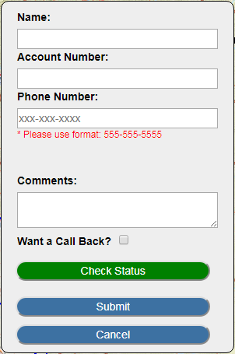
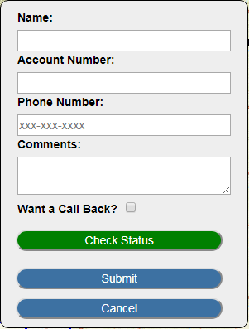
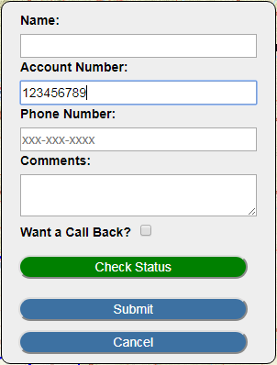
Outage Info IN - OMSWebMap
Reporting an Outage
Web Form Requirements
Phone number only required field
Specific format is required
Account Number
Overrides phone number requirement
Resolves in OMS
Notes:
Once Outage Reporting is enabled on your outage map customers will see a ‘Report an Outage’ button. They will use this to access the web form and report an outage.
<click>
Reporting an outage follows certain web form requirements.
<click>
The only field required to report an outage is “Phone Number”.
<click>
At very least, the outage report must contain a 10 digit phone number with the proper formatting.
The form will not allow a user to submit the outage report unless there is a phone number entered in this format.
<click>
Customers can also input their account number into the web form.
<click>
An account number is not required, but if an account number is entered into the form it will override the Phone Number requirement.
<click>
The account number is all that is needed to resolve the call in OMS.

Slide 10
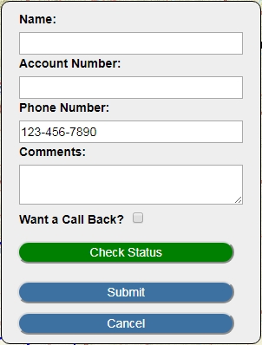
Outage Info IN - OMSWebMap
Resolved Calls
Valid account number is entered
Active account in OMS
Unresolved Calls
Only phone number is entered
Dispatch must link the call in OMS Client
Link call to active consumer
Call number provided
Use name to resolve to a consumer
Use comments and resolve to case
Notes:
Outage Reports in OMSWebMap will produce resolved and unresolved calls.
<click>
Resolved calls occur when the customer <click> enters a valid account number into the web form.
<click>
If the account is active and found in OMS, the call will be resolved and a call bundle will be created or it will automatically roll into an active case.
<click>
Unresolved calls occur when only a phone number is entered into the form.
<click>
As it sits right now dispatch must resolve the call in OMS Client manually; however, we are working on resolving the calls against the phone number entered into the form.
The problem with that is that the data will not always be current with the phone number being entered or the person is just simply entering a number that is not in your system. It usually will not match the phone number on the account so it is likely to end up as unresolved anyway.
That is why the account number has been the key value for resolving calls in OMS, but we are looking at extending call resolution to the phone number in the web form where account number is not available.
It will require changes to OMS proper to make this happen as well minor changes to the handling in the web form.
<click>
Dispatch will need to link the call in OMS Client.
<click>
They can use the number provided to link the call to active consumer.
<click>
They can call the number back and get further information about their outage.
<click>
They can use the name (if provided) to link to an active consumer.
<click>
They can use any comments provided and resolve the call to an ongoing case.

Slide 11
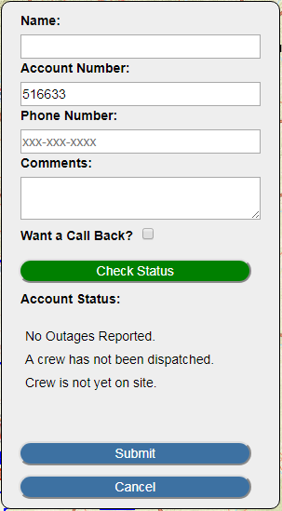
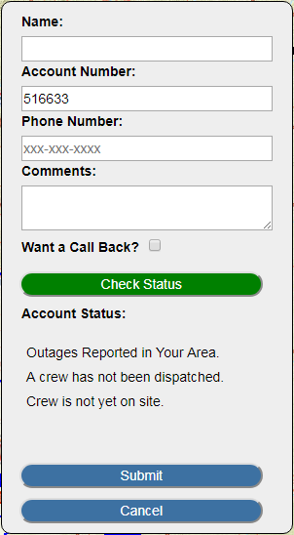
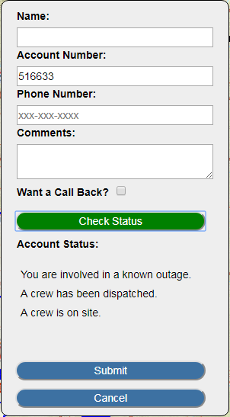
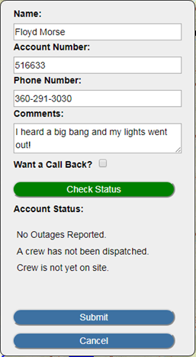

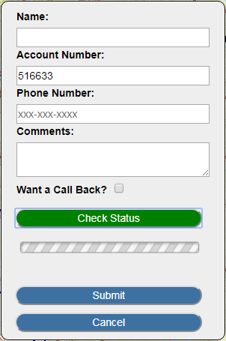
Outage Info OUT - OMSWebMap
Checking Outage Status
Account number required
Affected Consumer?
Relates to Case Status in OMS
Outages Reported in your Area (Call Bundle)
A crew has been dispatched (Predicted)
You are involved in a known outage (Confirmed)
No Outages Reported
Notes:
Now we will move to getting information on Outages out of your OMS.
One way to do that is through also through the Outage Reporting web form.
<click>
Your customers will be able to check their Account’s Outage Status using the Outage Reporting form.
<click>
A valid Account Number is required to check Outage Status.
<click>
Consumers can enter their account number and click “Check Status” <click> to see if they are an affected consumer in current outages.
<click>
Outage Status relates to the Case Status in OMS.
<click>
If they are in a Call Bundle, they will see “Outages Reported in your Area”.
<click>
If the case has reached a Predicted status, and Truck details are turned on, they will see “Outages Reported in Your Area” and more importantly “A crew has been dispatched”.
<click>
Finally if the case is confirmed, they will see “You are involved in a known outage”. A crew has been dispatched. A crew is on site.”
<click>
Now if a consumer is not affected in any case, they will see “No Outages Reported”.
<click>
At this point they will want to fill out the form and submit their outage report.
<click>

Slide 12
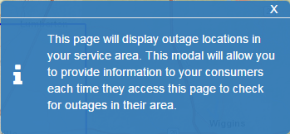
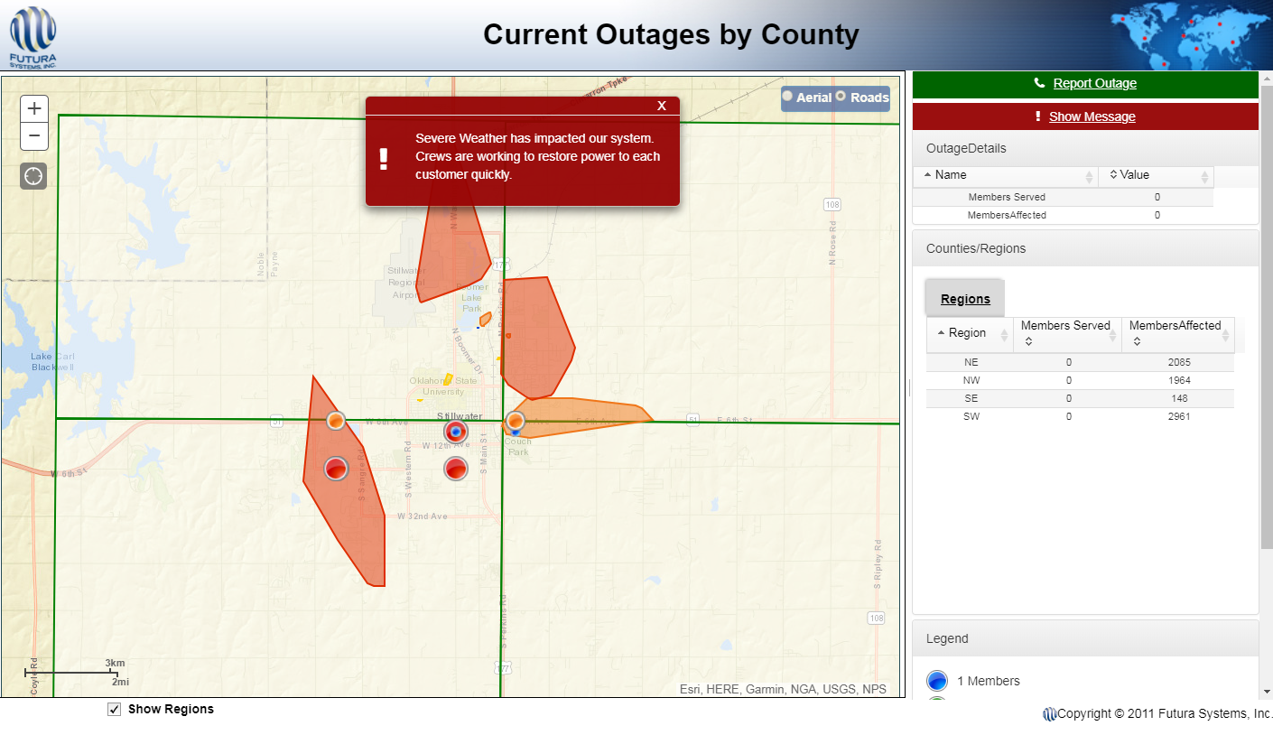
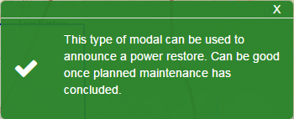
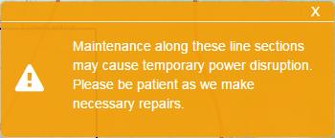
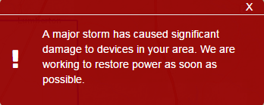
Outage Info OUT - OMSWebMap
Popup Modals
Provide information to your customers
Modal themes:
Info
Success
Warning
Error
Notes:
Another way to get information out to your consumers would be utilizing the Popup Modals in OMSWebMap.
<click>
These are popups that load when a user first navigates to your webpage. These are a great way to provide information to your consumers about upcoming or resolving events.
<click>
We have different types of modal themes for different types of information.
<click>
We have the info theme to provide general information
<click>
We have the Success theme to provide information on power resoration
<click>
We have the Warning theme to provide information on scheduled outages
<click> And finally the Error theme to provide information on incoming weather or major outage situations.

Slide 13
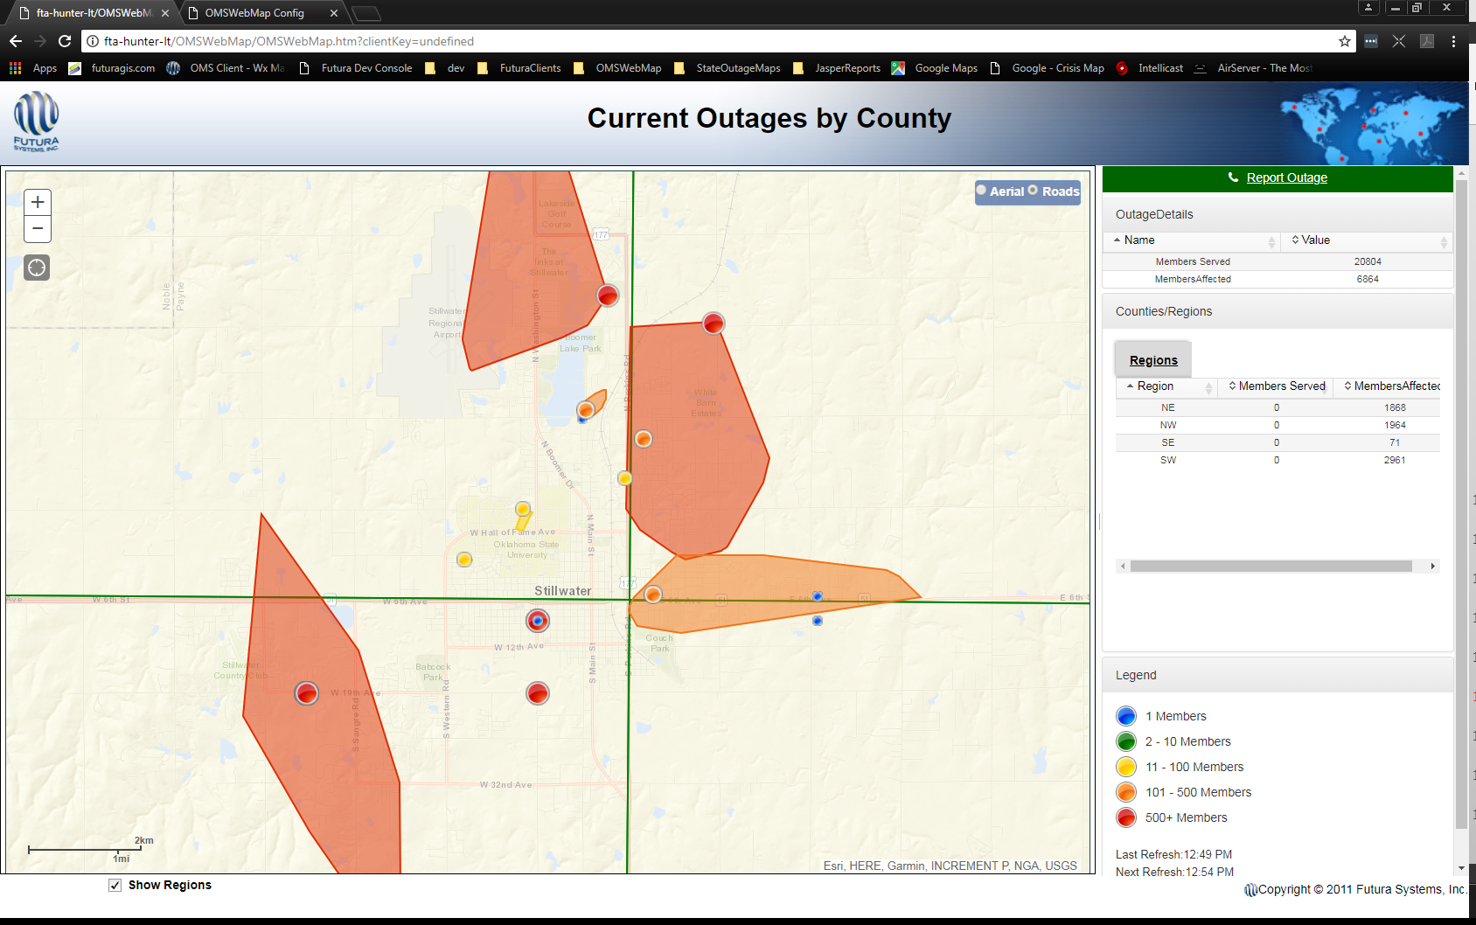
Outage Info OUT - OMSWebMap
New Outage Boundaries
Optional
Show Affected Areas
Predicted / Confirmed Cases
Trace farthest meters in outage
Notes:
The New Outage Boundaries on OMSWebMap can get information out to your customers that they are within an affected area of a known outage.
<click>
This feature is optional and can be turned on/off from the /Config page of OMSWebMap.
<click>
The boundaries show the affected area of outages on your system.
<click>
If enabled, affected areas will be displayed for Predicted and Confirmed Cases only. CallBundles will not display a boundary on the map.
<click>
The polygons are generated by tracing the farthest meters out in an outage and connecting those dots.
<click>
Here we can see OMSWebMap with the Outage Boundaries enabled.

Slide 14
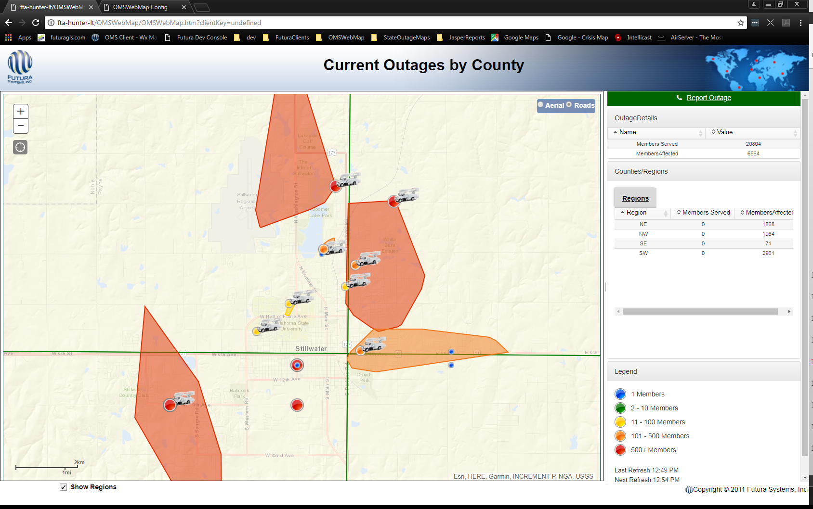
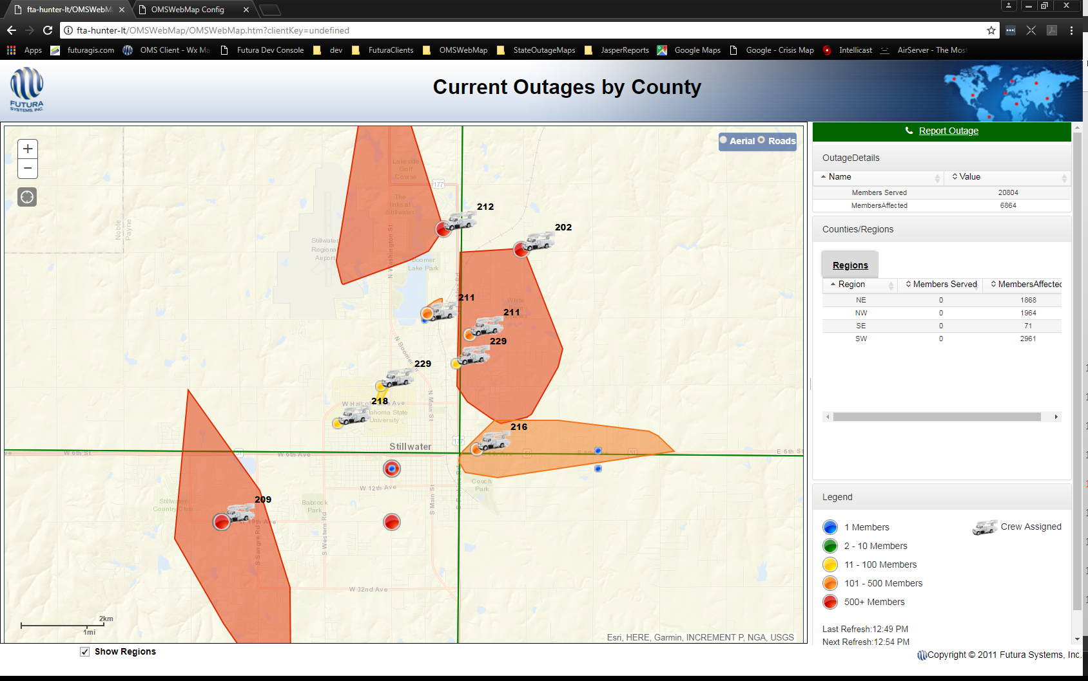
Outage Info OUT - OMSWebMap
New Assigned Truck Icons
Optional
Show Truck Assigned to Outage
Truck Names for Internal Use
Notes:
The New Outage Boundaries on OMSWebMap can get information out to your customers that they are within an affected area of a known outage.
<click>
This feature is also optional and can be turned on/off from the /Config page of OMSWebMap.
<click>
The truck icons will display for cases that have a truck currently assigned in OMS.
<click>
You also have the option to turn on the truck names for your internal only omswebmap. This can be very useful for operations on where trucks are currently assigned.
<click>
Here we can see OMSWebMap with the Truck Icons enabled.
<click>
And finally the same example with Truck Numbers or Names enabled.

Slide 15
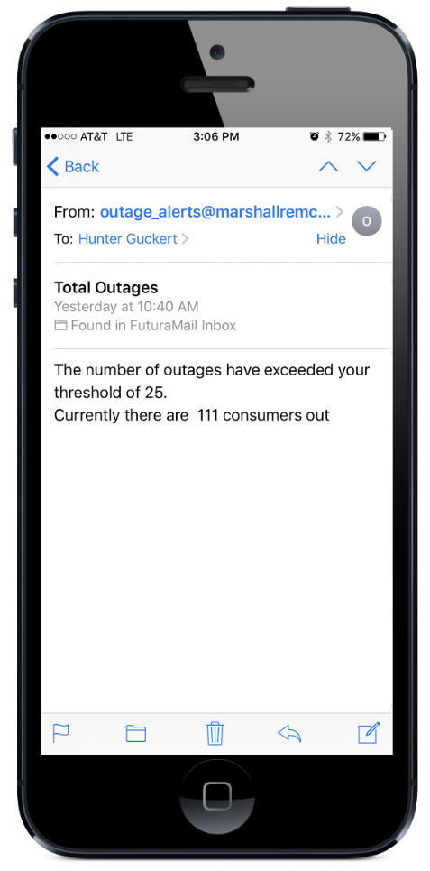
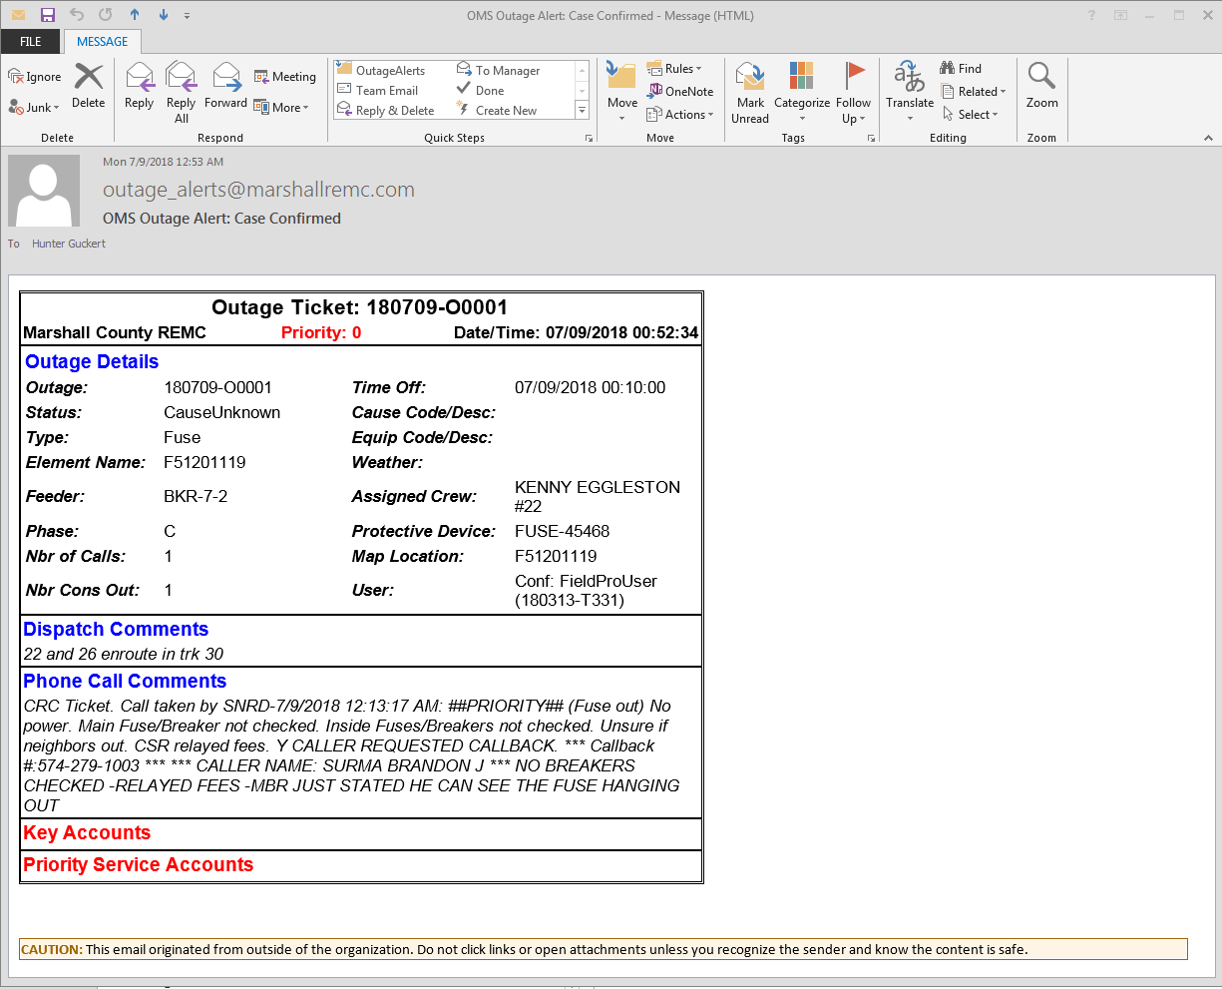
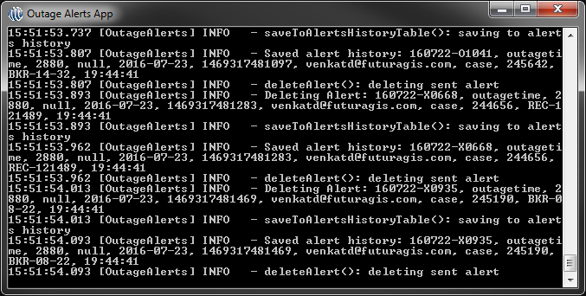
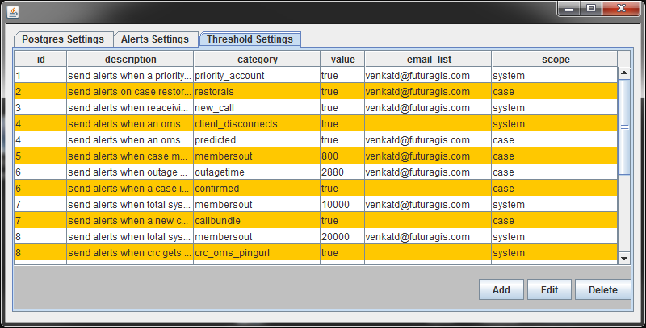
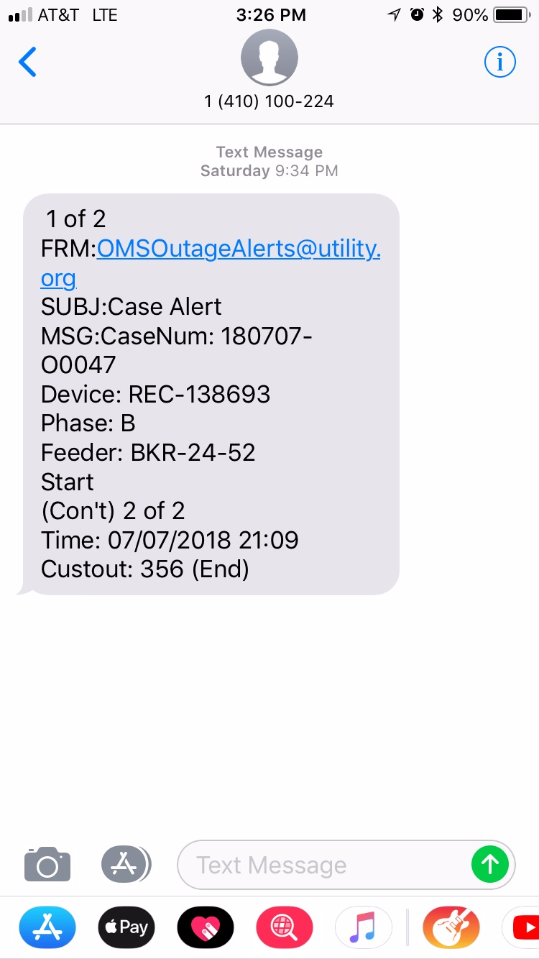

Outage Info OUT – Outage Alerts
Outage Alerts App
Runs on OMS Server
Issues:
Email
Text Messages
Based on:
Thresholds
Case Statuses
OMS
Notes:
The FuturaOMS Outage Alerts App is the best way to get outage information out to your key personnel as soon as conditions present themselves on your system.
<click>
The Outage Alerts app runs on the OMS server in a command window along side OMS Model and Save Data.
<click>
It is capable of issuing Email and SMS/Text Messages to cellular carrier addresses.
<click>
The alerts are based on customizable thresholds and/or Case Statuses in the system.

Slide 16
Outage Info OUT – Alert Types
System Alerts
Membersout (system wide)
New Call
Priority Account (xtraservice)
Key Account (account number)
CRC Registration Status
OMS Client Disconnects
Disk Space on OMS Machine
Case Alerts
Membersout (per case)
Call Bundle
Predicted
Confirmed
Restorals
Notes:
There are two main types, or scopes, for alerts. System Alerts and Case Alerts.
System alerts are a measure of system wide characteristics.
System alerts can be triggered when a total number of members are out system wide.
The main purpose of this type of alert is to give you a quick heads up to check in on the system. If your system goes over 100 membersout, you can notify a key set of people. If your system goes over 1000 members out, you can also notify a second set of people as soon as that happens.
We can alert any time a new call is logged in the system and any time a Priority Account (asthma, hospital) or Key Account (specific account number(s)) is involved in an outage.
Other system alerts are based on the system itself and not the outages.
CRC registration status can be monitored and alerts triggered if it is disrupted.
OMS Client Disconnects can be alerted to bring attention to network connectivity issues.
Disk Space on the OMS Server can even be monitored.
“Case” alerts are a measure of individual case statistics. They contain more detailed information about an outage and can be very useful to the lineman in the field. These alerts will include the case parameters from OMS, including the Case Memo, and Call Notes associated with the case. They can be issued at each stage in case status (Call Bundle > Predicted > Confirmed > Restored) so you can follow the progress of individual outages.
Keep in mind each of these alerts has its own content / format.

Slide 17
Outage Info OUT – New to Alerts
Added Support:
Authenticated email
TLS / SSL encryption
Text only email systems
In Development:
Alerts based on Call Volume
Alerts based on Feeder
Suppress Outage Alerts during certain time periods for a given list.
Notes:
New to Outage Alerts app since last year.
Support for authenticated email accounts. We can now pass the username and password to the email server for authentication.
Support for either TLS or SSL encrypted email protocols.
Text only functionality if your email is text only based.
In development:
Alerts based on Call Volume in the system.
Alerts by Feeder, to notify specific lists of lineman to outages on a circuit.
Supress Outage Alerts to a specific list between two time periods.

Slide 18

Outage I/O – Review
Improve Outage Communication
Outage Info IN
Outage Info OUT
Additional Configuration Required
We are here to help!
Get more out of your OMS
Streamline Communication
Notes:
This session has been about additional ways to get outage information into and out of OMS.<click>
The name of the game is Improving Communication by leveraging tools we already have built into your system.
<click>
Additional Configuration is required, but we are here to help you with that! If you are interested in any of these pieces, just let us know and we will help get things lined up.
<click>
You can get more out of your OMS, and streamline communication using these tools.

Slide 19

Outage I/O - Recap
Outage Reporting
Built in to OMSWebMap
Reduces Call Volume
Customer interface to OMS
New OMSWebMap Features
Popup Modals
Affected Boundaries
Truck Icons
Outage Alerts App
Alert key personnel to outage conditions automatically
Keep tabs on system / machine conditions
Notes:
Outage Reporting is already built into OMSWebMap.
It can help reduce call volume by providing your customers with another interface to OMS.
<click>
New features in OMSWebMap give you additional means to communicate outage information to your customers. Popup Modals allow you to communicate important information.
Affected boundaries can help increase you customer’s awareness that they are inside a known outage.
Truck icons let them know that you’re on the ball when cases are already assigned to trucks!
<click>
Finally, the Outage Alerts App keeps your personnel in tune with outages conditions in the system. It can also keep key staff aware of conditions on the server to help keep things running smooth.

Slide 20
QUESTIONS?

